Slide 1
Neural Network
Unit III

Slide 2
Brain : a computational machine?
Information processing: brains vs computers
brains better at perception / cognition
slower at numerical calculations
parallel and distributed Processing
associative memory

Slide 3
Brain : a computational machine? (contd.)
Evolutionarily, brain has developed algorithms most suitable for survival
Algorithms unknown: the search is on
Brain astonishing in the amount of information it processes
Typical computers: 10⁹ operations/sec
Housefly brain: 10¹¹ operations/sec

Slide 4
Brain facts & figures
Basic building block of nervous system: nerve cell (neuron)
~ 10¹² neurons in brain
~ 10¹⁵ connections between them
Connections made at “synapses”
The speed: events on millisecond scale in neurons, nanosecond scale in silicon chips

Slide 5
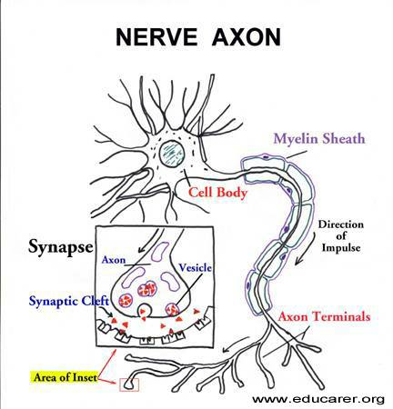
Neuron - “classical”
Dendrites
Receiving stations of neurons
Don't generate action potentials
Cell body
Site at which information
received is integrated
Axon
Generate and relay action
potential
Terminal
Relays information to
next neuron in the pathway
http://www.educarer.com/images/brain-nerve-axon.jpg

Slide 6
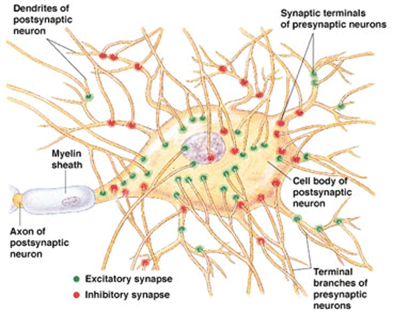
Computation in Biological Neuron
Incoming signals from synapses are summed up at the soma
, the biological “inner product”
On crossing a threshold, the cell “fires” generating an action potential in the axon hillock region
Synaptic inputs: Artist’s conception

Slide 7
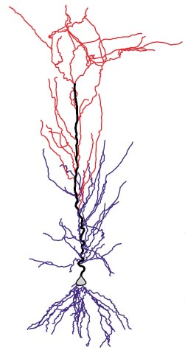
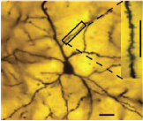
The biological neuron
Pyramidal neuron, from the amygdala (Rupshi et al. 2005)
A CA1 pyramidal neuron (Mel et al. 2004)

Slide 8
A perspective of AI
Artificial Intelligence - Knowledge based computing
Disciplines which form the core of AI - inner circle
Fields which draw from these disciplines - outer circle.
Robotics
NLP
Search,
RSN,
LRN
Expert
Systems
Planning
CV

Slide 9
Symbolic AI
Connectionist AI is contrasted with Symbolic AI
Symbolic AI - Physical Symbol System Hypothesis
Every intelligent system can be constructed by storing and processing symbols and nothing more is necessary.
Symbolic AI has a bearing on models of computation such as
Turing Machine
Von Neumann Machine
Lambda calculus

Slide 10
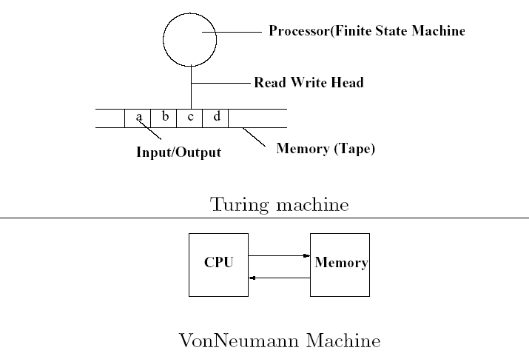
Turing Machine & Von Neumann Machine

Slide 11
Challenges to Symbolic AI
Motivation for challenging Symbolic AI
A large number of computations and information process tasks that living beings are comfortable with, are not performed well by computers!
The Differences
Brain computation in living beings TM computation in computers
Pattern Recognition Numerical Processing
Learning oriented Programming oriented
Distributed & parallel processing Centralized & serial processing
Content addressable Location addressable

Slide 12
Perceptron

Slide 13
The Perceptron Model
A perceptron is a computing element with input lines having associated weights and the cell having a threshold value. The perceptron model is motivated by the biological neuron.
Output = y
Threshold = θ
w_{n}
w₁
W_{n-1}
x₁
X_{n-1}

Slide 14
y
1
θ
Σw_{i}x_{i}
Step function / Threshold function
y = 1 for Σw_{i}x_{i} >=θ
=0 otherwise

Slide 15
Features of Perceptron
Input output behavior is discontinuous and the derivative does not exist at Σw_{i}x_{i} = θ
Σw_{i}x_{i} - θ is the net input denoted as net
Referred to as a linear threshold element - linearity because of x appearing with power 1
y= f(net): Relation between y and net is non-linear

Slide 16
Computation of Boolean functions
AND of 2 inputs
X1 x2 y
0 0 0
0 1 0
1 0 0
1 1 1
The parameter values (weights & thresholds) need to be found.
y
θ
w₁
w₂
x₁
x₂

Slide 17
Computing parameter values
w1 * 0 + w2 * 0 <= θ ➔ θ >= 0; since y=0
w1 * 0 + w2 * 1 <= θ ➔ w2 <= θ; since y=0
w1 * 1 + w2 * 0 <= θ ➔ w1 <= θ; since y=0
w1 * 1 + w2 *1 > θ ➔ w1 + w2 > θ; since y=1
w1 = w2 = = 0.5
satisfy these inequalities and find parameters to be used for computing AND function.

Slide 18
Other Boolean functions
OR can be computed using values of w1 = w2 = 1 and = 0.5
XOR function gives rise to the following inequalities:
w1 * 0 + w2 * 0 <= θ ➔ θ >= 0
w1 * 0 + w2 * 1 > θ ➔ w2 > θ
w1 * 1 + w2 * 0 > θ ➔ w1 > θ
w1 * 1 + w2 *1 <= θ ➔ w1 + w2 <= θ
No set of parameter values satisfy these inequalities.

Slide 19
Threshold functions
n # Boolean functions (2^2^n) #Threshold Functions (2^{n2})
1 4 4
2 16 14
3 256 128
64K 1008
Functions computable by perceptrons - threshold functions
#TF becomes negligibly small for larger values of #BF.
For n=2, all functions except XOR and XNOR are computable.

Slide 20
Concept of Hyper-planes
∑ w_{i}x_{i} = θ defines a linear surface in the (W,θ) space, where W=<w₁,w₂,w₃,…,w_{n}> is an n-dimensional vector.
A point in this (W,θ) space
defines a perceptron.
y
θ
w₁
w₂
w₃
w_{n}
. . .
x₁
x₂
x₃
x_{n}

Slide 21
Perceptron Property
Two perceptrons may have different parameters but same functional values.
Example of the simplest perceptron
w.x>0 gives y=1
w.x≤0 gives y=0
Depending on different values of
w and θ, four different functions are possible
y
θ
w₁
x₁

Slide 22
Simple perceptron contd.
True-Function
x
f1
f2
f3
f4
θ<0
W< θ
0
0
0
1
1
1
0
1
0
1
0-function
Identity Function
Complement Function
θ≥0
w≤θ
θ≥0
w> θ
θ<0
w≤ θ

Slide 23
Counting the number of functions for the simplest perceptron
For the simplest perceptron, the equation is w.x=θ.
Substituting x=0 and x=1,
we get θ=0 and w=θ.
These two lines intersect to
form four regions, which
correspond to the four functions.
θ
w=θ
R4
R1
w
R3
θ=0
R2

Slide 24
Fundamental Observation
The number of TFs computable by a perceptron is equal to the number of regions produced by 2^{n} hyper-planes,obtained by plugging in the values <x₁,x₂,x₃,…,x_{n}> in the equation
∑_{i=1}^{n}w_{i}x_{i}= θ

